Slide 1
Introducing OCUDU to OTICS Feb 5, 2025
For more information, contact Sarat Puthenpura (sarat@opennetworking.org)

Slide 2
Introduction
An OTIC (Open Testing and Integration Center) serves as a neutral, open facility to test, integrate, and validate O-RAN–based solutions from multiple vendors before large-scale commercial deployment.
An OTIC acts as the bridge between R&D and real-world deployment, ensuring that open, multi-vendor RAN solutions are interoperable, secure, and deployment-ready
Strategy:
Start with COSMOS (Rutgers WINLAB) and expand to other OTICs https://cosmos-lab.org/

Slide 3
Advantages to start with COSMOS
Long history of wireless networking R&D - hosting Open RAN PoCs and plug fests since 2019
Extensive COSMOS city-scale indoor/outdoor testbed as part of NSF Platforms for Advanced Wireless Research program (with Columbia University and NYU) – including SDR, cloud networking, FCC innovation zone
COSMOS at Rutgers University WINLAB was established early on in Jan 2023 as the east coast North American OTIC
During 2025/2026, WINLAB established POET testbed for O-RAN energy and performance testing - leveraging open-source CU/DU/Core (e.g., srsRAN, OAI) and several commercial O-RUs
Since 2025/2026, WINLAB is also an O-RAN SC Test & Integration site
Hosted open-source based energy savings demo shown at Feb 2026 O-RAN Rome meeting
Active collaboration with NTIA T&E projects (ORCID, ACCoRD)
Strong wireless networking research and education program, open-source focus, as well as alignment with industry

Slide 4
Steps involved in introducing OCUDU to OTIC Prepare → Integrate → Validate → Iterate → Certify
Define onboarding scope and objectives, for example:
Interoperability (RU ↔ DU, DU ↔ CU, CU ↔ RIC), O-RAN compliance
Performance benchmarking, security, stability, and scale testing
Align with OTIC intake requirements, for example:
Hardware availability (x86/ARM servers, accelerators), Cloud stack (K8s version, OpenShift, VMware, bare metal), Transport and timing infrastructure (PTP, SyncE)
Prepare OCUDU software artifacts
Container images or VM images : O-CU-CP, O-CU-UP, O-DU, Helm charts / deployment manifests
Configuration templates: F1-C / F1-U, E1, O1 (NETCONF/YANG), E2 (if Near-RT RIC is involved)
Interface readiness checklist
Ensure all mandatory interfaces are implemented and documented
Security and compliance preparation
Provide TLS certificates, Key management procedures, Role-based access control definitions
Align with O-RAN Security Architecture (WG11) and OTIC security baseline tests
Deploy OCUDU in OTIC environment
Install on OTIC-approved infrastructure: Bare metal with accelerators and/or Cloud-native Kubernetes platform
Integrate with OTIC SMO, Near-RT RIC (if applicable), Test RU(s) from one or more vendors
Bring-up the system and do sanity checks
Verify DU ↔ RU link up and timing lock, CU ↔ DU F1 setup, UE attach, registration, and data session
Execute OTIC test campaigns
Typical sequence : Conformance tests (O-RAN spec compliance); Interoperability tests (Multi-vendor RU, RIC, SMO); Performance tests (Throughput, latency, jitter); Stability and longevity tests (Soak tests, fault recovery); Security tests (Interface protection, failure scenarios)
Issue resolution and iteration
Debug interop issues jointly with OTIC and peer vendors,
Update configurations, software builds, interface behavior and re-run impacted test cases
Documentation and certification outcomes
Deliverables typically include OTIC test reports, Interop matrices, and performance benchmarks
Results may feed into operator procurement decisions, O-RAN Alliance feedback loops, standards bodies, pre-commercial or field trials

Slide 5
Example: Interface Readiness Checklist
Interface | Validation focus
Open Fronthaul | DU–RU interoperability, timing, compression
F1-C / F1-U | CU–DU signaling and user plane
E2 | RIC connectivity, service models
A1 | Policy control
O1 | FCAPS via SMO
N2/N3 | Core network connectivity
Xn | gNB-gNB interface

Slide 6
Who performs OTIC testing?
OTIC Host (primary test executor)
This is the neutral party that runs the lab and executes the tests
Their role:
Own and operate the test infrastructure
Define test procedures and acceptance criteria
Execute tests hands-on
Collect logs, KPIs, and metrics
Produce official OTIC artifacts (interop matrices, reports)
Their neutrality is the entire point of an OTIC
Vendor engineering teams (supporting role)
Vendors whose O-CU / O-DU / RU is under test do not “run” the OTIC tests, but they are involved
Provide deployable software/images, supply configuration documentation, answer clarification questions, fix bugs discovered during testing and validate reproduction of issues
What vendors do not do → Decide pass/fail, modify test criteria mid-run, control test execution, or publish the final conclusions
This separation is critical for credibility
Operators / enterprises (requirements and validation role)
They typically define real-world use cases, review test plans for relevance, observe selected tests, validate that results answer procurement questions, consume OTIC outputs for deployment decisions
They usually do not run the tests
Standards bodies (indirect, not hands-on)
Organizations like the O-RAN Alliance and 3GPP, define specifications, publish test specifications and profiles, accredit or recognize OTICs (e.g. O-RAN)

Slide 7
“Who touches the keyboard” View
OTIC Engineers / Lab Staff ← RUN the tests
(neutral host organization)
Vendors ← Support & Fix
(CU / DU / RU)
End users
(Operators / Gov / Enterprises) ← Define needs, consume results

Slide 8
Next Immediate Steps
Define scope
Align with OTIC – COSMOS (Rutgers WINLAB)
Create and execute SoW between LFN and WINLAB

Slide 9
BACKUP INFO

Slide 10

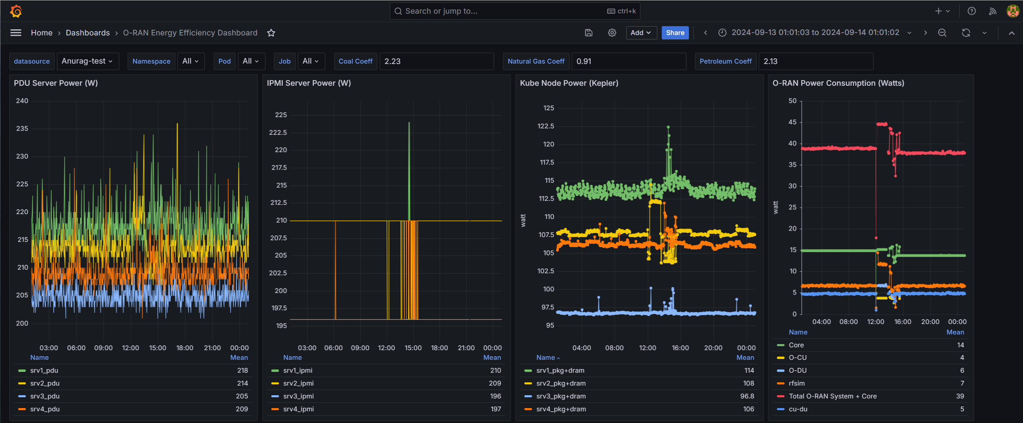
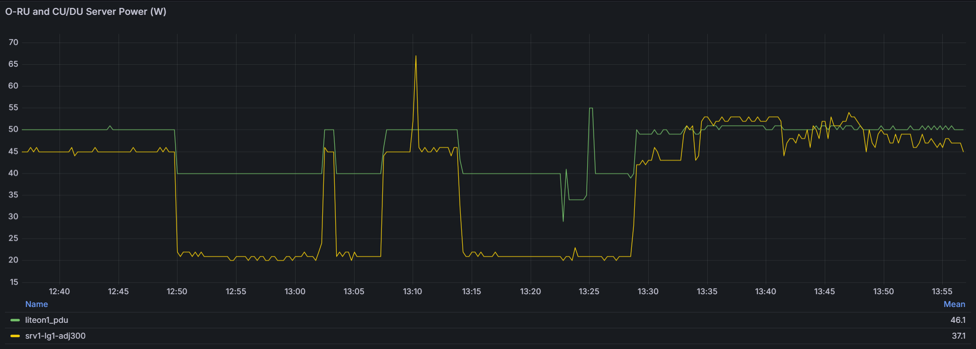

POET: Platform for O-RAN Energy Efficiency Testing
Automated
Data Collection
PDU power KPI
(all physical equipment)
IPMI/ Redfish power KPI
(all servers)
Kepler/ Scaphandre power KPI
(VNF/CNF)
UE-Emulator
Grafana Dashboards
SMO/OAM
(OFH-MP controller)
End-to-end testing
UE (Phone)
OAI, srsRAN, Amarisoft
Core
CU
DU
RU-1
UE (Modem)
Bare-metal & BubbleRAN O-RAN (Kubernetes)
PTP
GM Switch
RU-2
Prometheus
DB
antennas
RU-N
switch
DU Emulator
Emulated testing
cables
MongoDB
(Offline data)
Vector
Signal Analyzer
DC Power Supply
PDUs

Slide 11
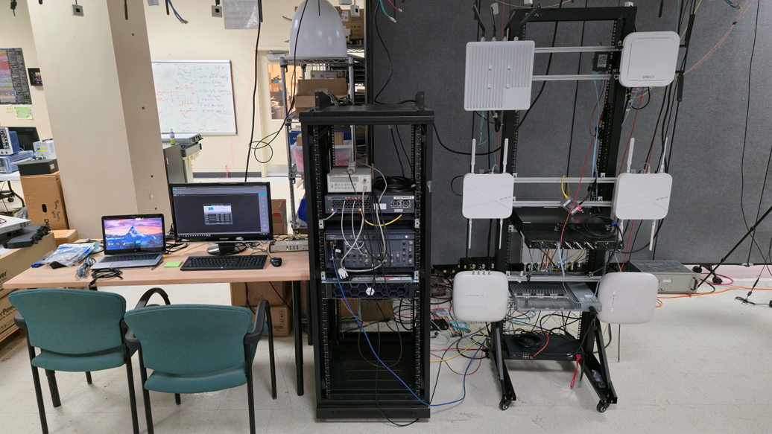
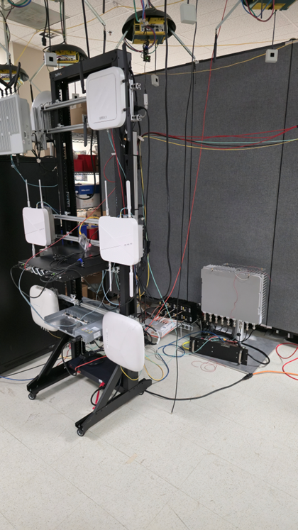
O-RAN Testbed at WINLAB
Platform for O-RAN Energy Efficiency and Performance Testing (POET)
Several commercial O-RUs (low to high power, 4-antenna and 8-antenna RUs)
Established setup for secure and scheduled for remote testing

